Slide 1



Research Data Management: Data management plan
Daniel Kwaro & Sammy Khagayi

Slide 2
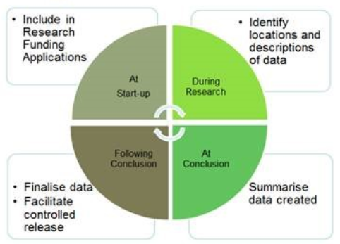
What is a data management plan?
A formal document that outlines what you will do with your data during and after a research project.
Most researchers collect data with some form of plan in mind, but it's often inadequately documented and incompletely thought out.
Many data management issues can be handled easily or avoided entirely by planning ahead.

Slide 3
What is a data management plan?
A formal document that outlines what you will do with your data during and after a research project.
Most researchers collect data with some form of plan in mind, but it's often inadequately documented and incompletely thought out.
Many data management issues can be handled easily or avoided entirely by planning ahead.
A DATA MANAGEMENT AND SHARING PLAN HELPS RESEARCHERS CONSIDER, WHEN RESEARCH IS BEING DESIGNED AND PLANNED, HOW DATA WILL BE MANAGED DURING THE RESEARCH PROCESS AND SHARED AFTERWARDS WITH THE WIDER RESEARCH COMMUNITY

Slide 4
Data management plan
The contents of the data management plan should include:
Data management checklist
Types of data to be collected
Standards that would be applied, e.g. formats and metadata
Roles and responsibilities for data management
Costing data management
Strategies and resources for research centres and hubs
Provisions for archiving and preservation
Access policies and provisions
Plans for eventual transition or termination of the data collection in the long-term future.
………………………and much more!

Slide 5
Example funder policies
National Science Foundation
“Proposals submitted … must include a supplementary document of no more than two pages labeled "Data Management Plan".”
Wellcome Trust
“Data sharing plans should address seven key questions as clearly and concisely as possible, as noted in the Trust's Guidance for researchers: Developing a data management and sharing plan”

Slide 6
Example DMPs
……Review examples
…….Create a DMP using online tool
http://projects.ands.org.au/policy.php
http://www.ands.org.au/working-with-data/datamanagement/data-management-plans#International-2
http://www.ands.org.au/working-with-data/datamanagement/data-management-plans#Discipline_specific_DMPs-3
https://riojournal.com/browse_journal_articles.php?form_name=filter_articles&sortby=0&journal_id=17&search_in_=0&section_type%5B%5D=231

Slide 7
Acknowledgements

